Slide 1
Numerical ODEs and stochastic models in Python
2020/1/28
Wenzhong Wang
wwz@live.unc.edu

Slide 2
About me
Name: Wenzhong Wang
Preferred name: Wang
Email: wwz@live.unc.edu
Junior. Math major.
Research: Dynamical systems, climate science.
SIAM member. UNC student chapter of SIAM member.
MCRN member.

Slide 3
Contents
1. ODEs from previous problems, plot in Python
2. simple stochastic model: Markov chain model in Python

Slide 4
2. Markov chain model
Problem: Suppose that whether or not it rains today depends on previous weather conditions through the last two days.
state 0 (S₀): if it rained both today and yesterday,
state 1 (S₁): if it rained today but not yesterday,
state 2 (S₂): if it rained yesterday but not today,
state 3 (S₃): if it did not rain either yesterday or today.

Slide 5
state 0 (S₀): if it rained both today and yesterday,
state 1 (S₁): if it rained today but not yesterday,
state 2 (S₂): if it rained yesterday but not today,
state 3 (S₃): if it did not rain either yesterday or today.
And given probabilities for tomorrow’s weather conditions,
state 00 (S₀₀): tomorrow will rain if it rained today and yesterday → P₀₀ = 0.7,
state 10 (S₁₀): tomorrow will rain if it rained today but not yesterday → P₁₀ = 0.5,
state 21 (S₂₁): tomorrow will rain if it rained yesterday but not today → P₂₁ = 0.4,
state 31 (S₃₁): tomorrow will rain if it did not rain yesterday or today → P₃₁ = 0.2.

Slide 6
Can we calculate more probabilities?
It follows immediately that,
state 02 (S₀₂): tomorrow won’t rain if it rained today and yesterday →
P₀₂ = 1 − 0.7 = 0.3,
state 12 (S₁₂): tomorrow won’t rain if it rained today but not yesterday →
P₁₂ = 1 − 0.5 = 0.5,
state 23 (S₂₃): tomorrow won’t rain if it rained yesterday but not today →
P₂₃ = 1 − 0.4 = 0.6,
state 33 (S₃₃): tomorrow won’t rain if it did not rain either yesterday or today →
P₃₃ = 1 − 0.2 = 0.8.

Slide 7
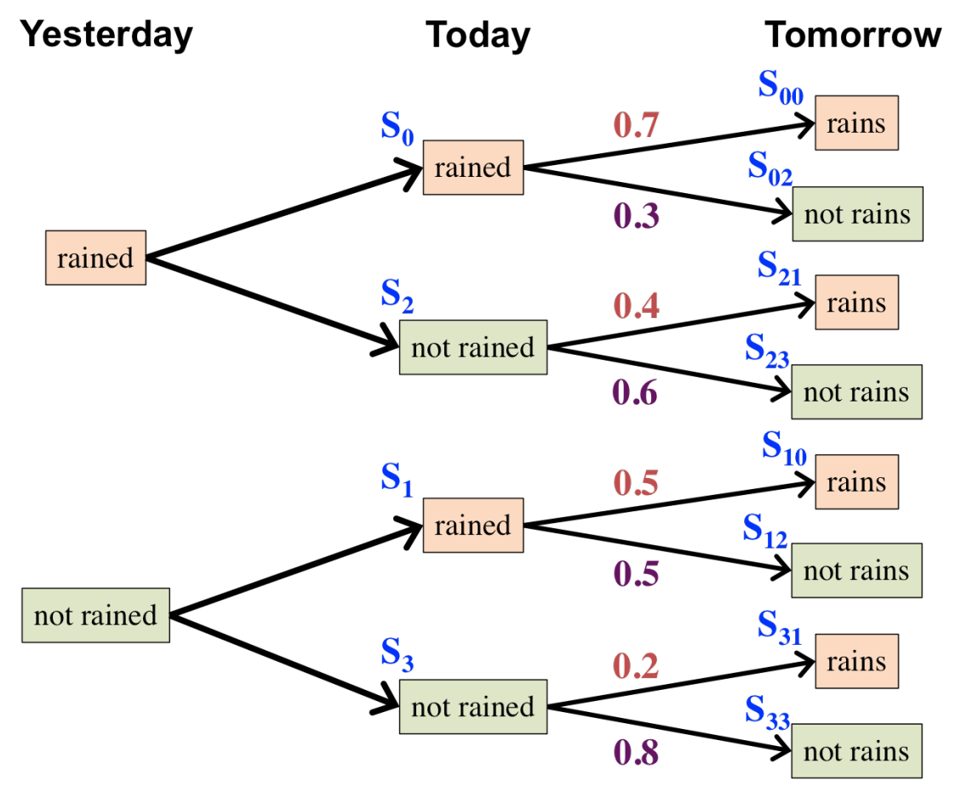
Summary
Whenever the process in any state, it will be next in another state, but with a fixed probability in transition.
Such a stochastic process is an example of Markov chain. (not formal definition)

Slide 8
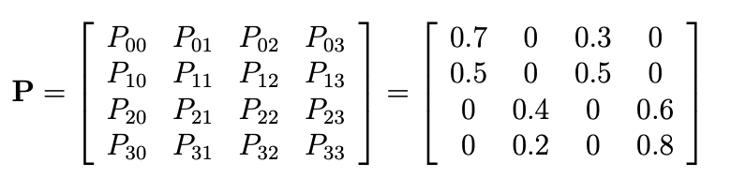
It’s natural to express transition probabilities in a matrix:
state 0 (S₀): if it rained both today and yesterday,
state 1 (S₁): if it rained today but not yesterday,
state 2 (S₂): if it rained yesterday but not today,
state 3 (S₃): if it did not rain either yesterday or today.

Slide 9
Transition probability matrix
state 0 (S₀): if it rained both today and yesterday,
state 1 (S₁): if it rained today but not yesterday,
state 2 (S₂): if it rained yesterday but not today,
state 3 (S₃): if it did not rain either yesterday or today.
Properties:
1. Entries of the matrix are non-negative
2. Sum of any row is 1

Slide 10
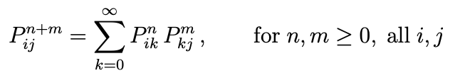
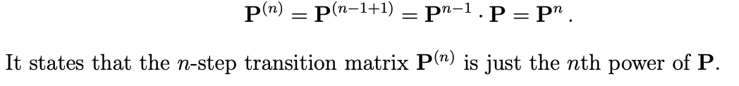
Transition probability matrix
state 0 (S₀): if it rained both today and yesterday,
state 1 (S₁): if it rained today but not yesterday,
state 2 (S₂): if it rained yesterday but not today,
state 3 (S₃): if it did not rain either yesterday or today.
Chapman-Kolmogorov equations
In this example,

Slide 11

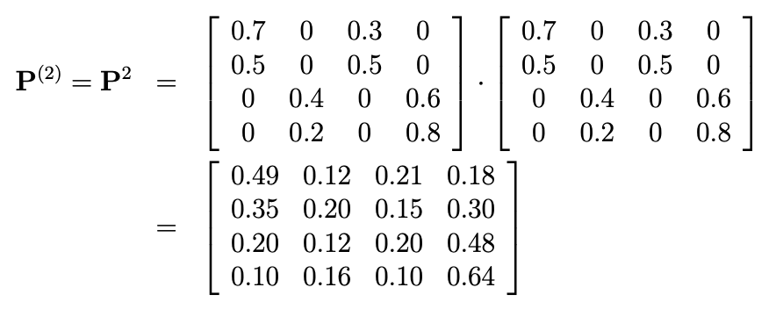
Transition probability matrix
Chapman-Kolmogorov equations
In this example
For instance, transition from (today) to (the day after tomorrow),

